Slide 1
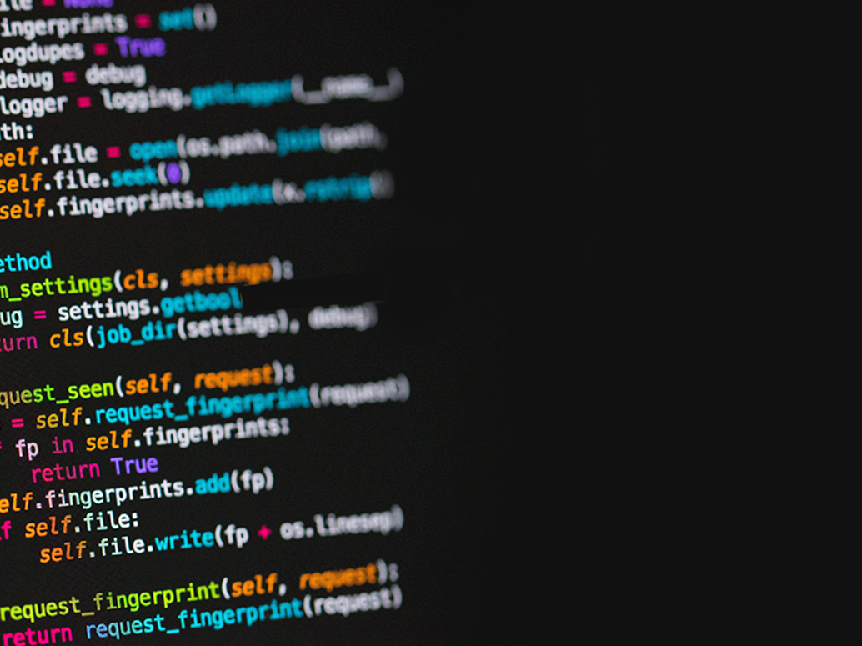

For loops, functions, and strings

Slide 2
Recap!
We should know how to…
Create variables
Format strings using .format()
Use escape sequences
Know if else statements
Know while statements

Slide 3
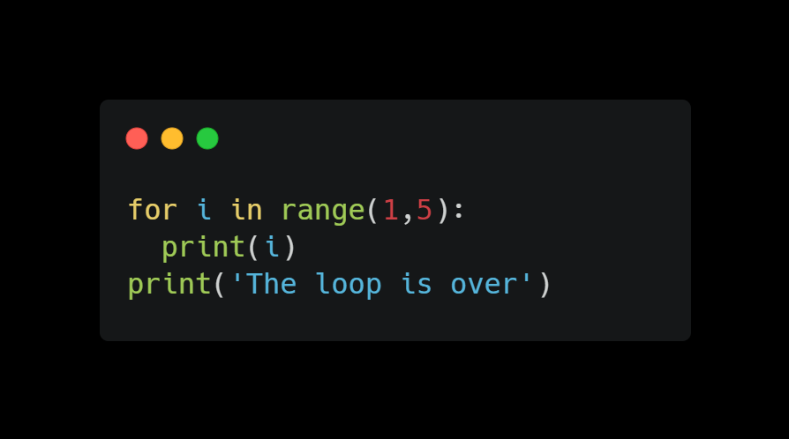
For loop
Another looping statement which iterates over a sequence of objects
Starts with 0
You can always create for loops using while but it takes more lines
Can nest a for loop inside a for loop
Returns a sequence of numbers starting from 0
Variable that holds the current position in the loop

Slide 4
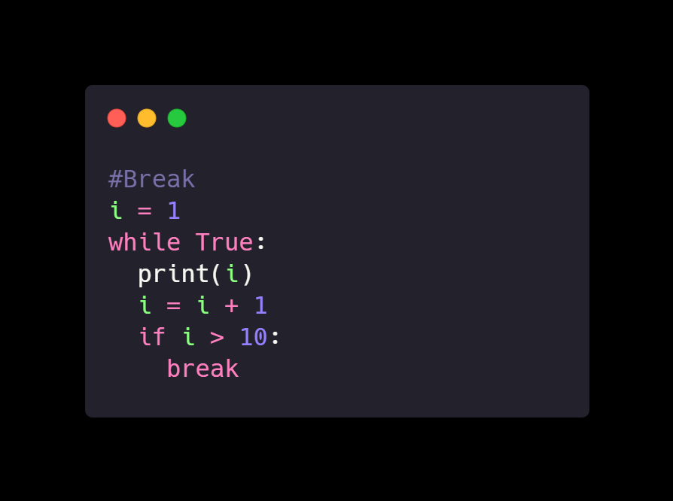
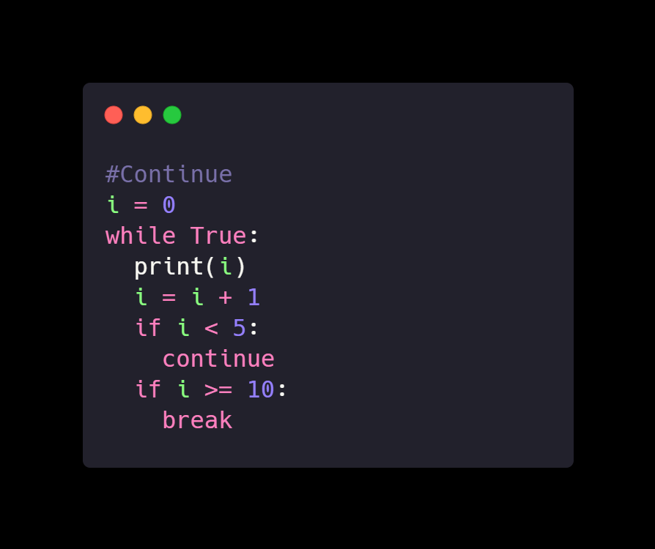
Break vs continue
Break is used to terminate/stop the loop in where it is present
Continue is used to skip a certain part of the loop but continue on with the loop

Slide 5
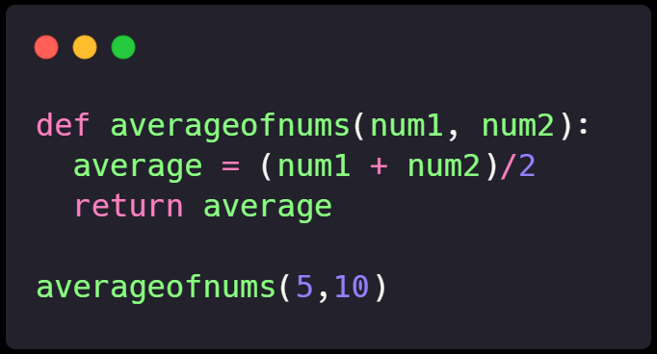
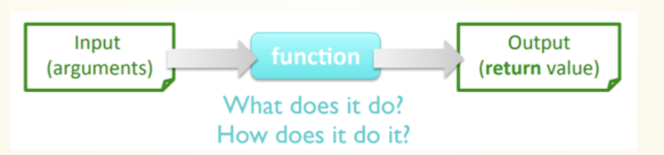
functions
Functions are used to perform tasks (store blocks of code)
Reusable programs that can be called
May take arguments and parameters
Great way to organize code (make them into blocks)
Function Name
Function Arguments
Keyword
Calling function with args

Slide 6
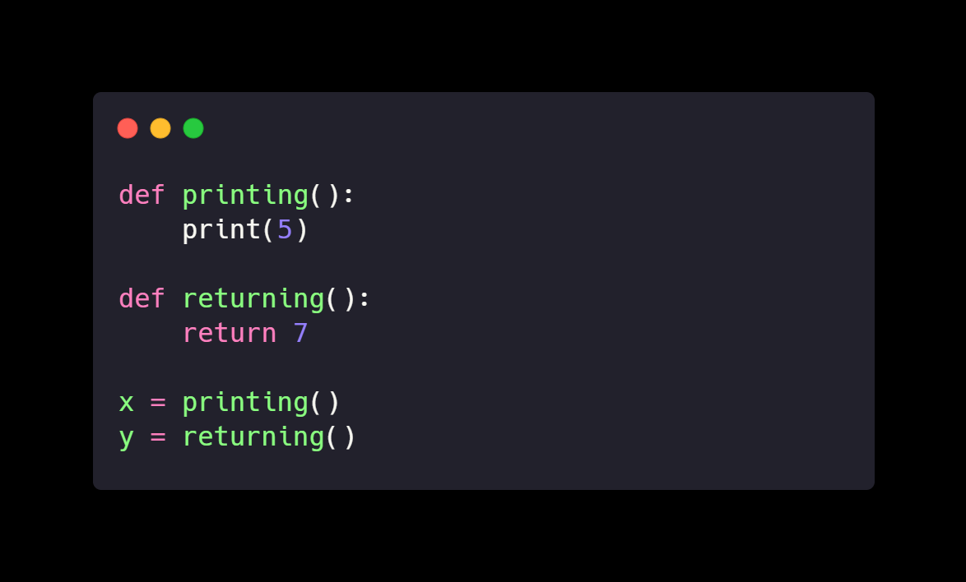
Print vs return
Print shows the user an output representing what is going on inside the computer. The computer cannot make use of what's printed (not stored or affect the function)
Return is how a function gives back a value. Unseen by user but can be used by the computer for further instructions

Slide 7
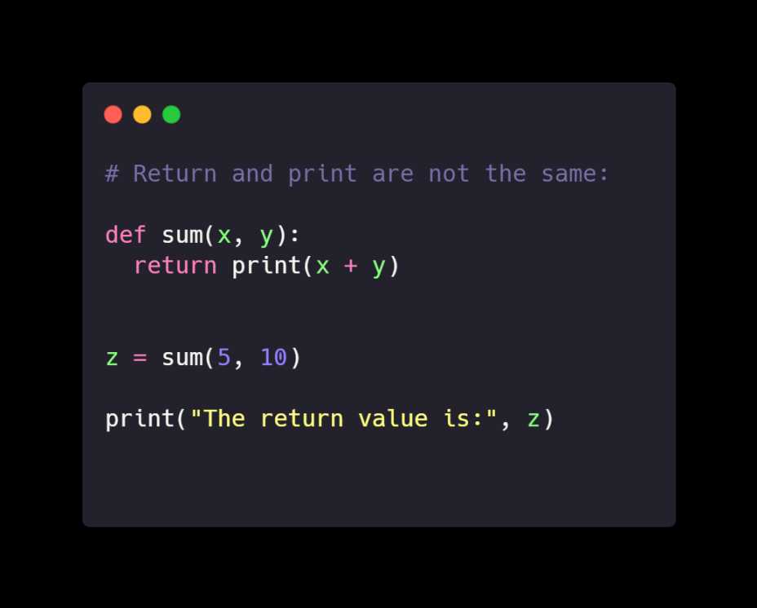
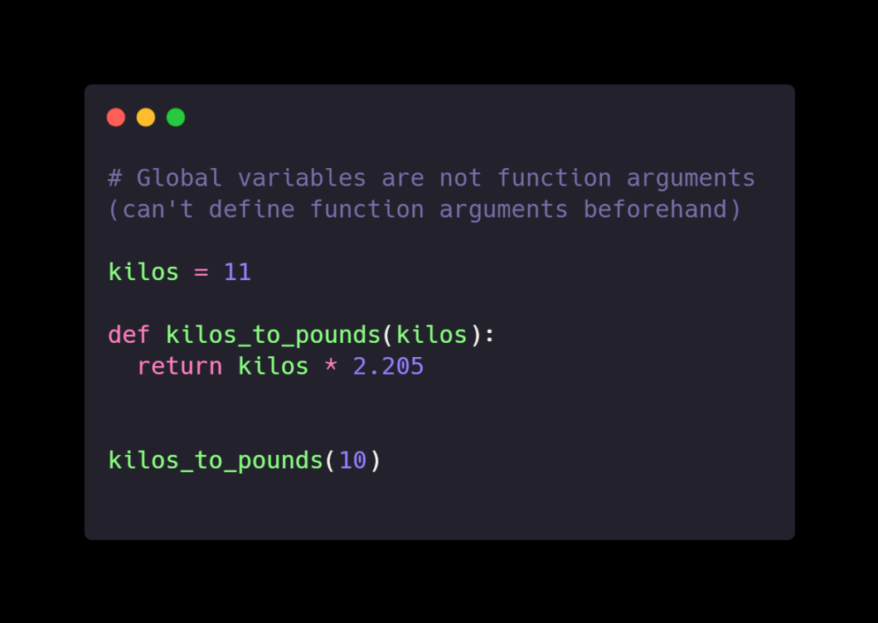
Common mistakes in functions
Break is used to terminate/stop the loop in where it is present
Continue is used to skip a certain part of the loop but continue on with the loop

Slide 8
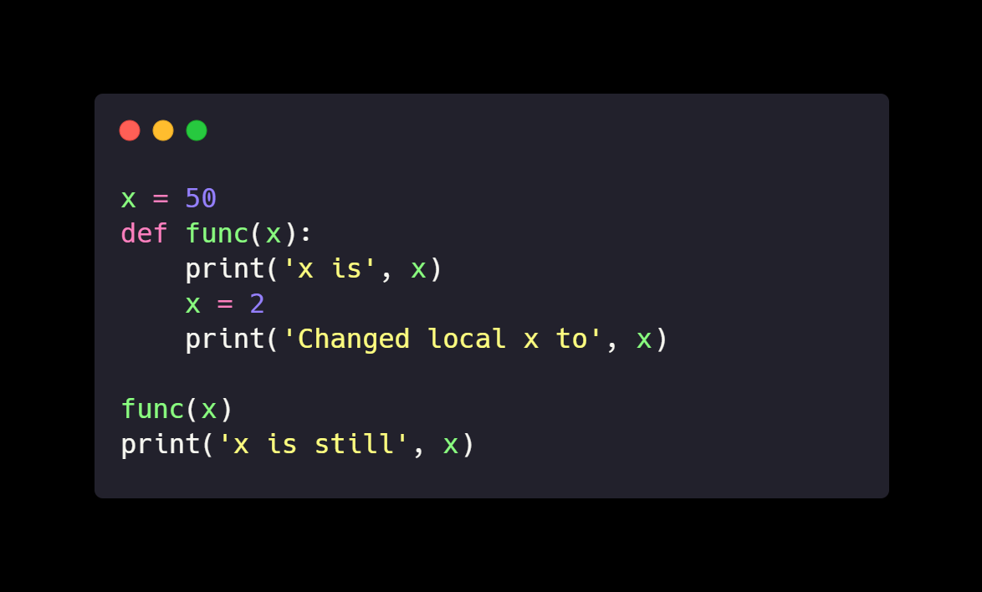
Local variables
Local variables are variables declared inside a function
Not related and cannot be used outside of the function specified

Slide 9
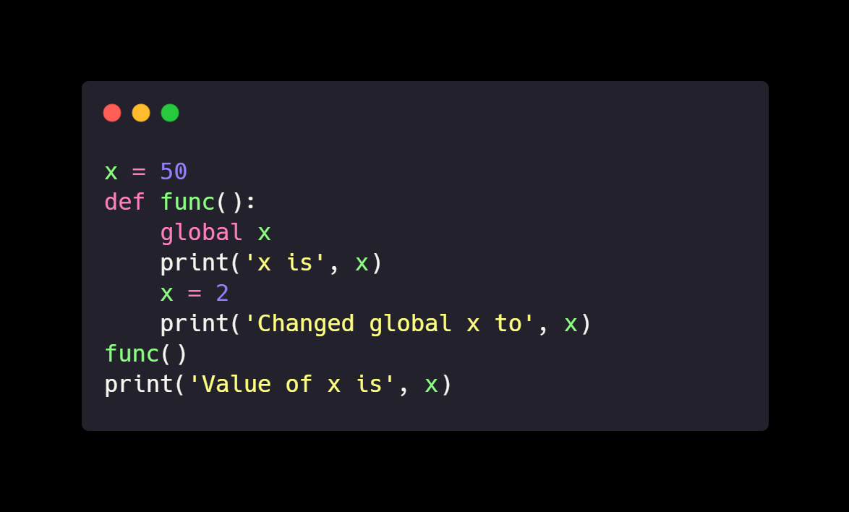
global variables
Defining a variable outside of the function
Be careful of accidentally changing the value of the global variable
Use the global statement

Slide 10
String functions
We know that strings are defined in quotations or apostrophes (‘/”)
How can we “change” strings?
Strings are immutable (will mention more later)
Character encoding
String operators
Length function
Split, join, upper, lower, format (we mentioned this in previous workshop)

Slide 11
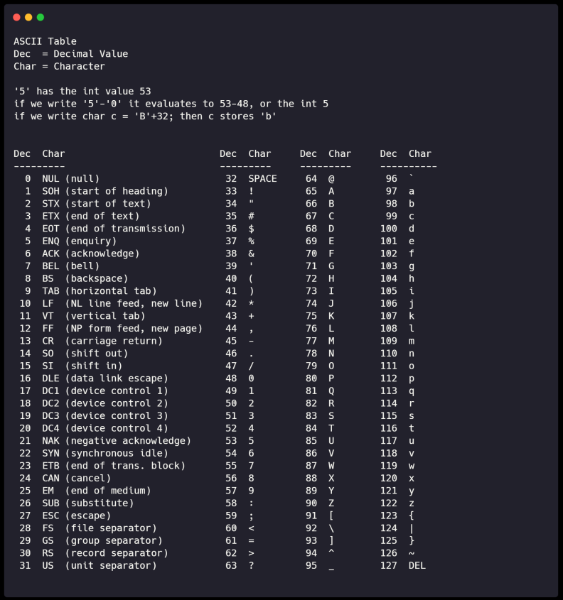
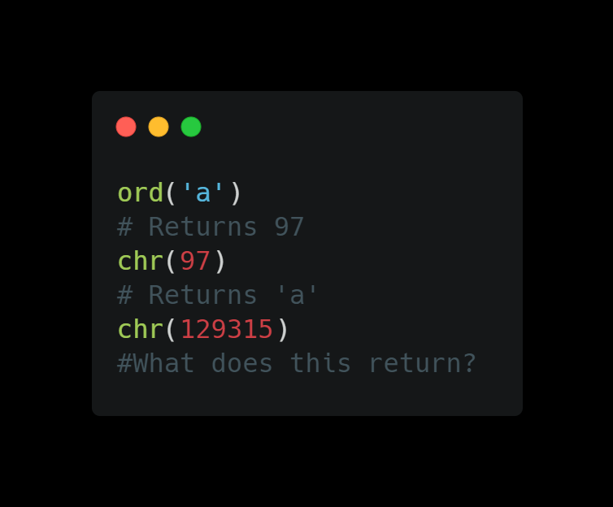
Character encoding
A string is stored as a sequence of binary numbers (in decimal shown in ascii table)
Converting characters to numbers and vice-versa is called character encoding
Python 3 uses Unicode (We can print other languages and emojis!!)

Slide 12
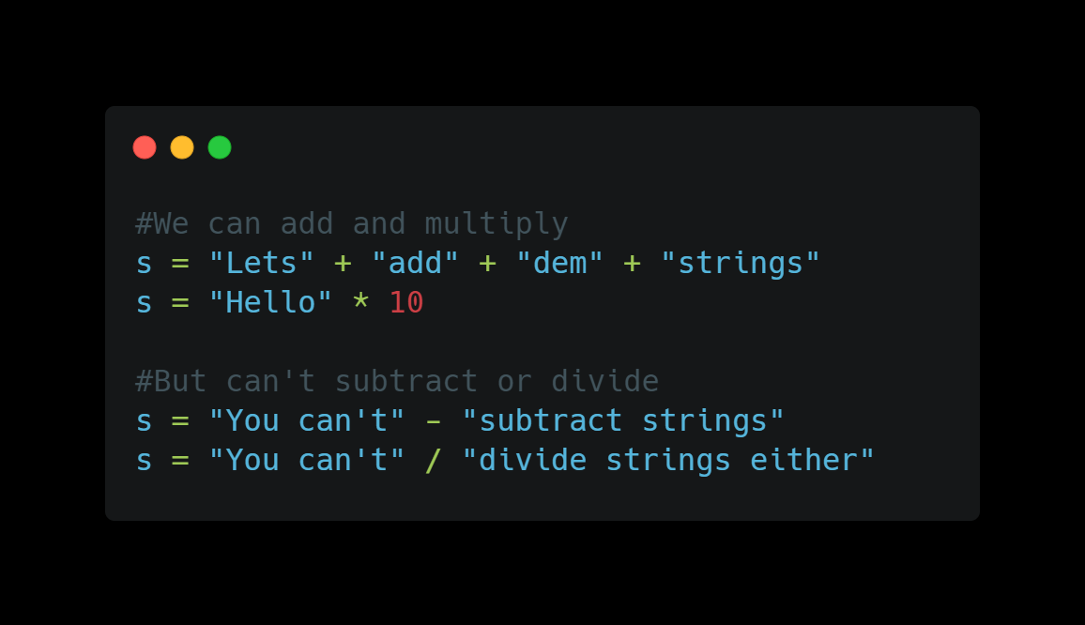
String operators
Concatenation
Multiplication
No subtraction or division

Slide 13
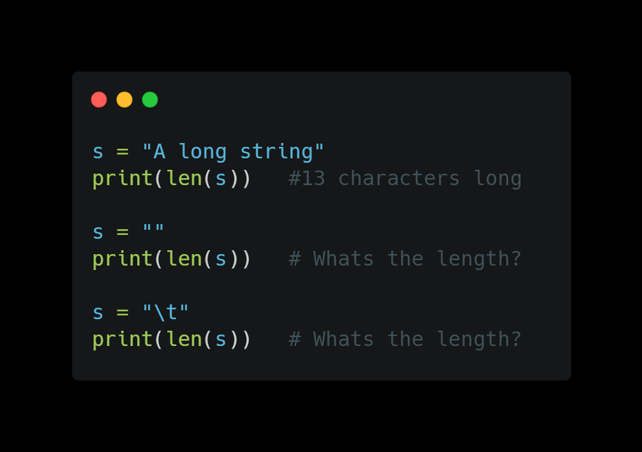
Length function
How do we find the length of a string?
We can use len()

Slide 14
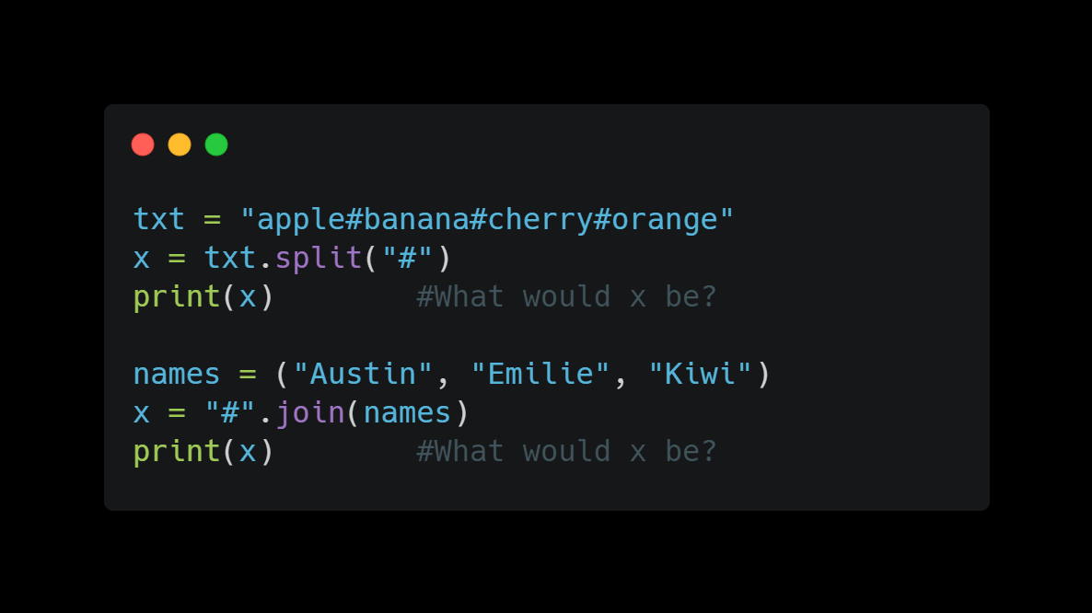
.Split/.join
The split method splits the string into a list
The join method joins strings

Slide 15
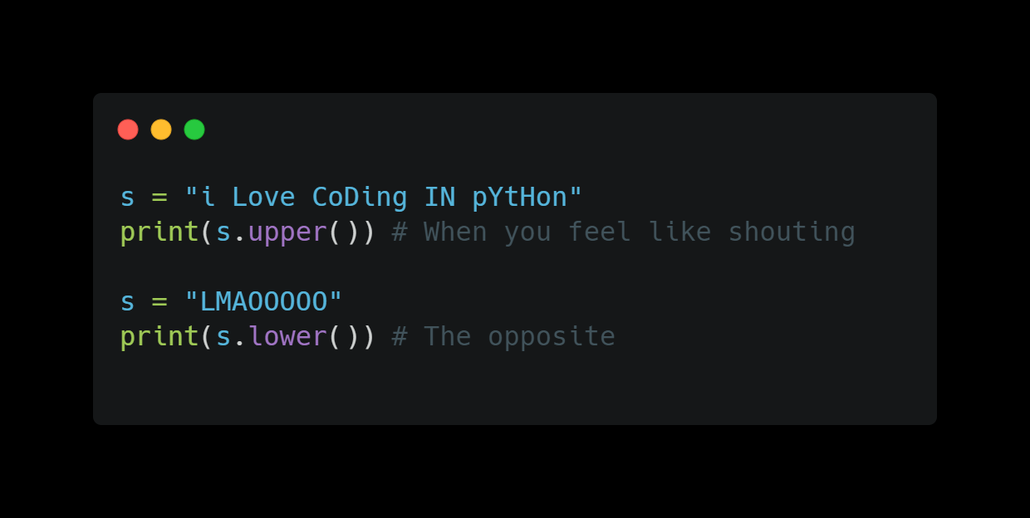
.upper/.lower
Converts the string to all caps
Converts the string to lower case

Slide 16
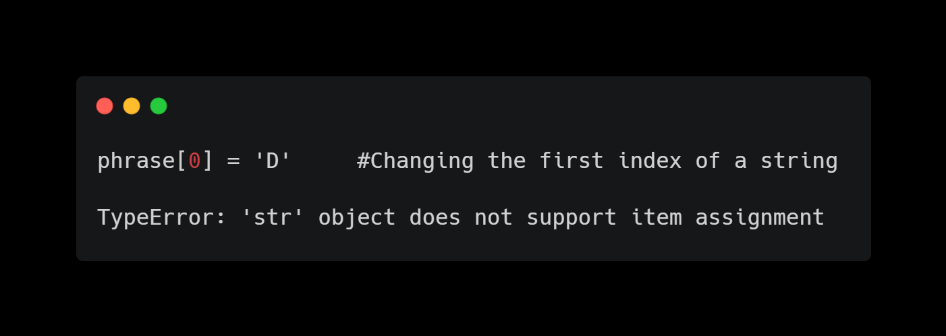
immutability
An immutable object is an object that is not changeable and its state cannot be modified after it is created.
In Python, a string is immutable. You cannot overwrite the values of immutable objects.

Slide 17
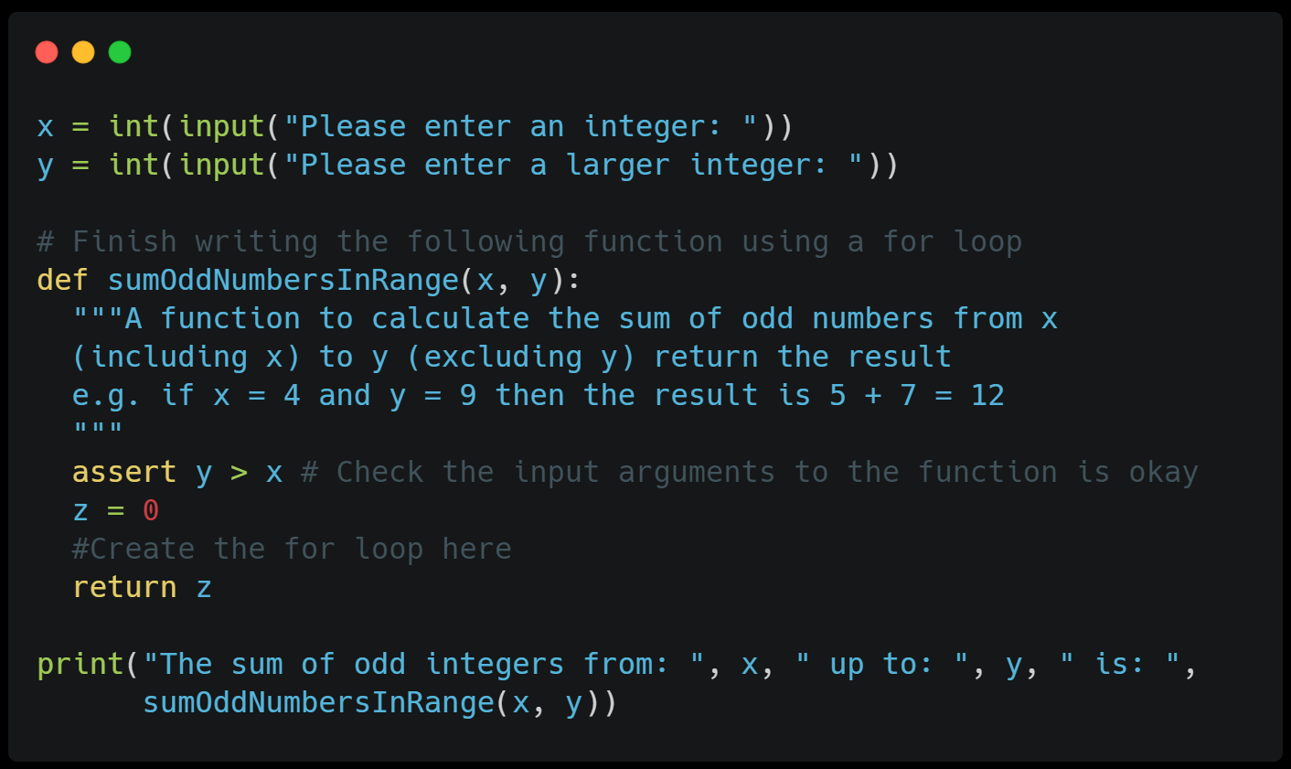
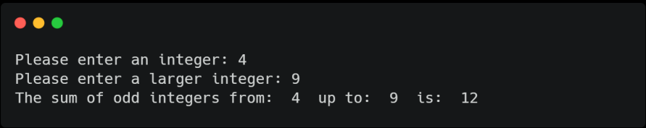
Challenge!!
Complete the function using a for loop.The function takes in 2 arguments x and y.
Hint: Create a for loop that takes in x and y, then check if the number is an odd number. Add all the odd numbers to z (takes around 3 lines)

Slide 18
Thanks!!
Email: ayyen@ucsc.edu

